Slide 1

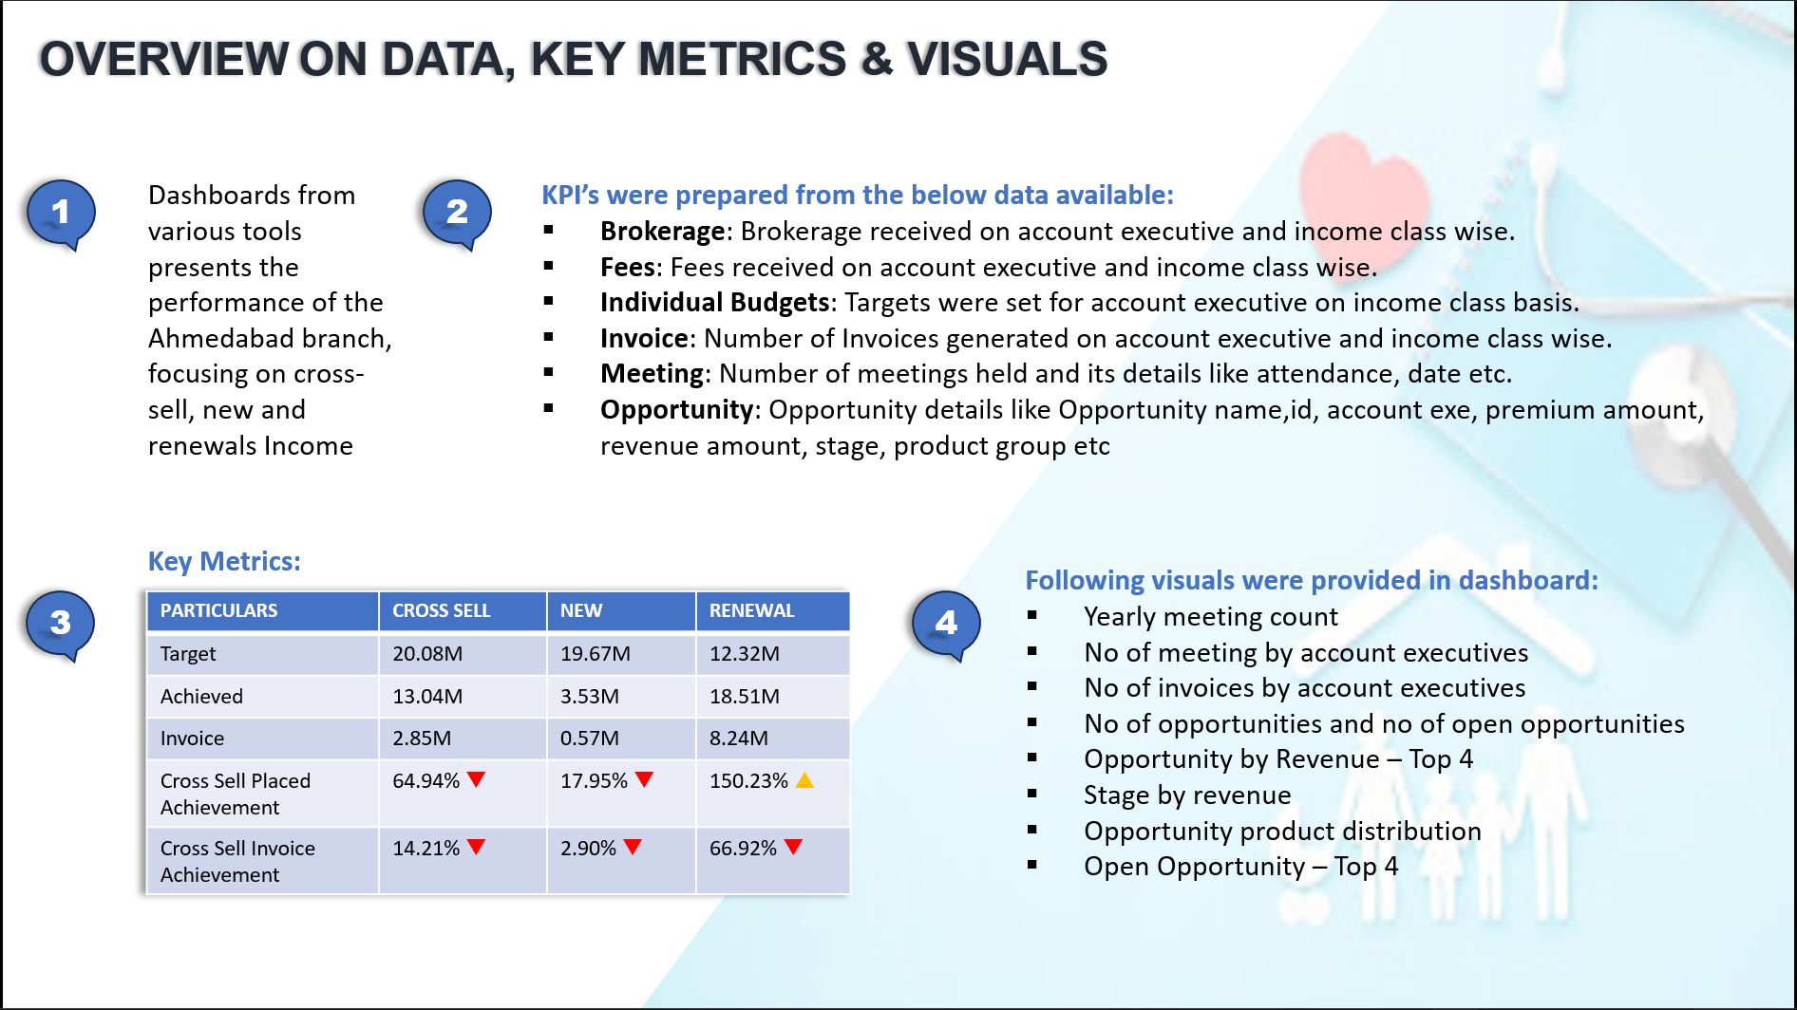
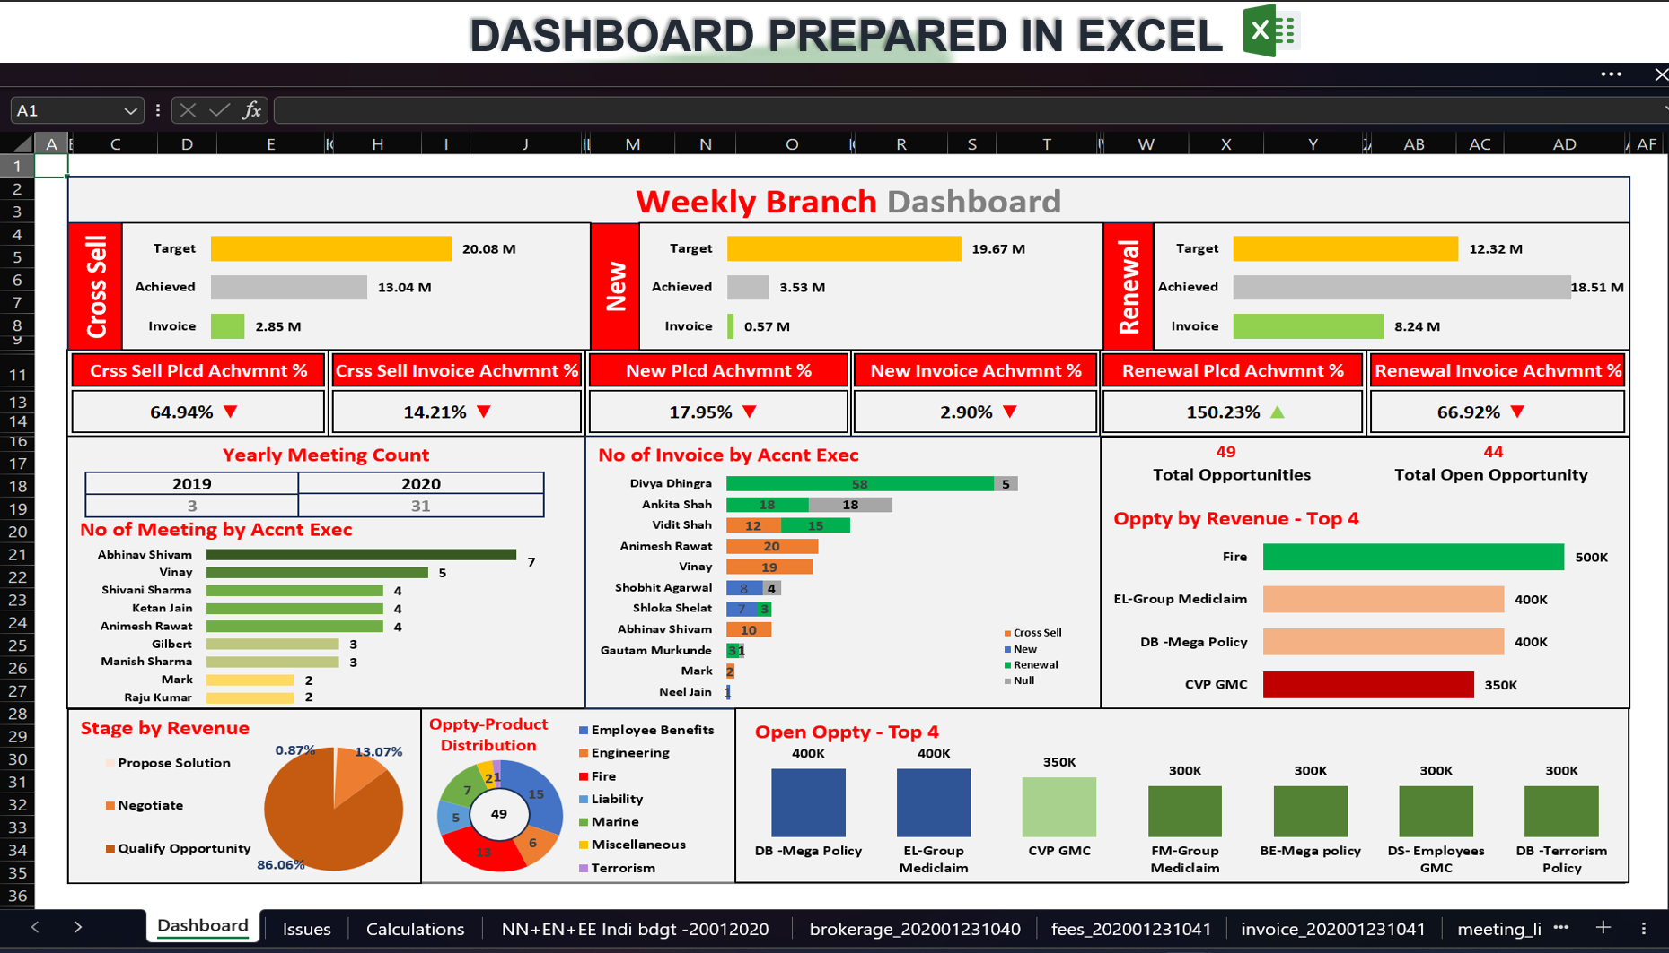
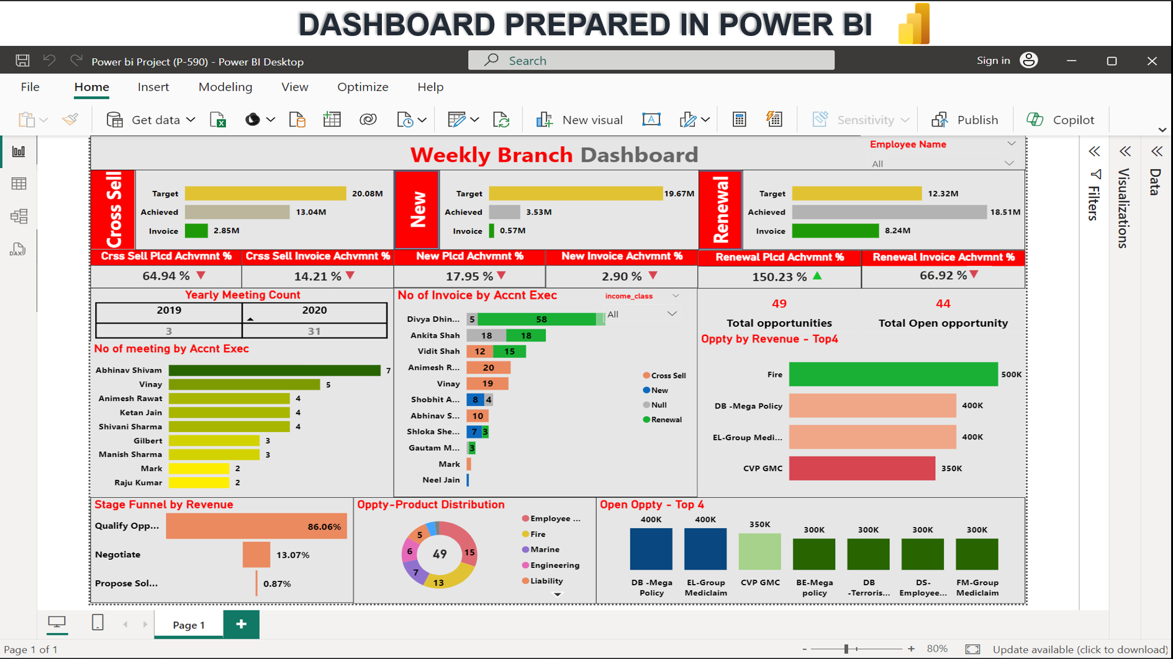
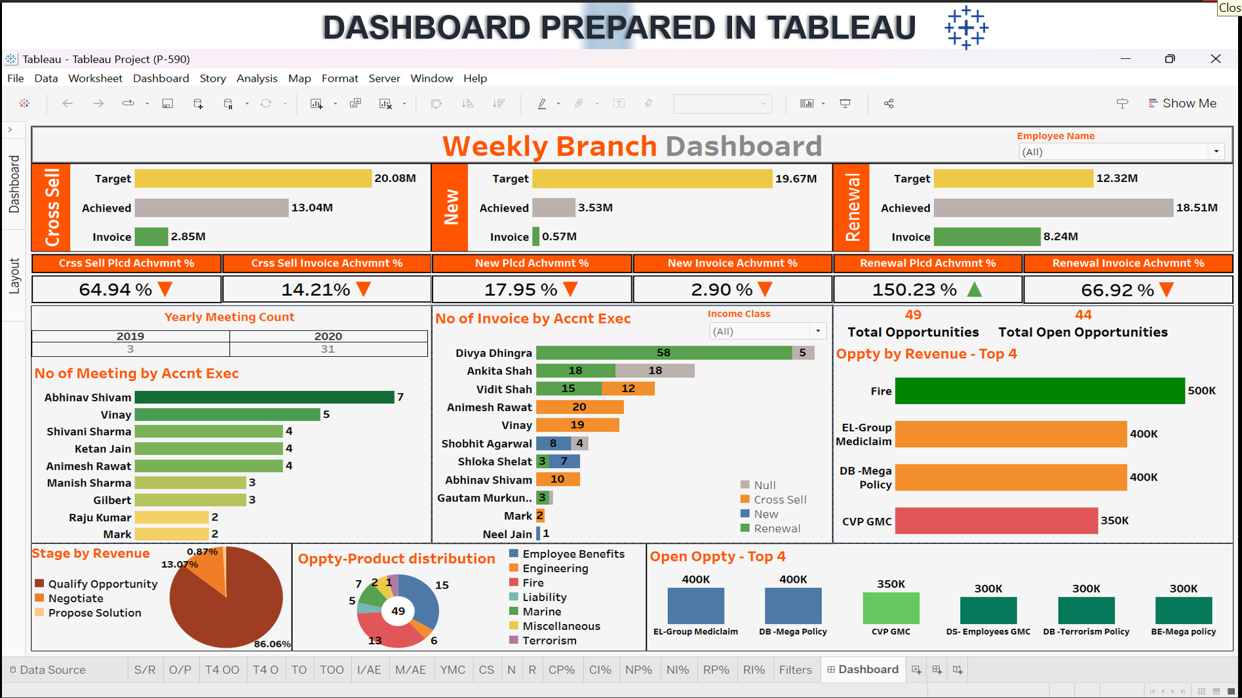

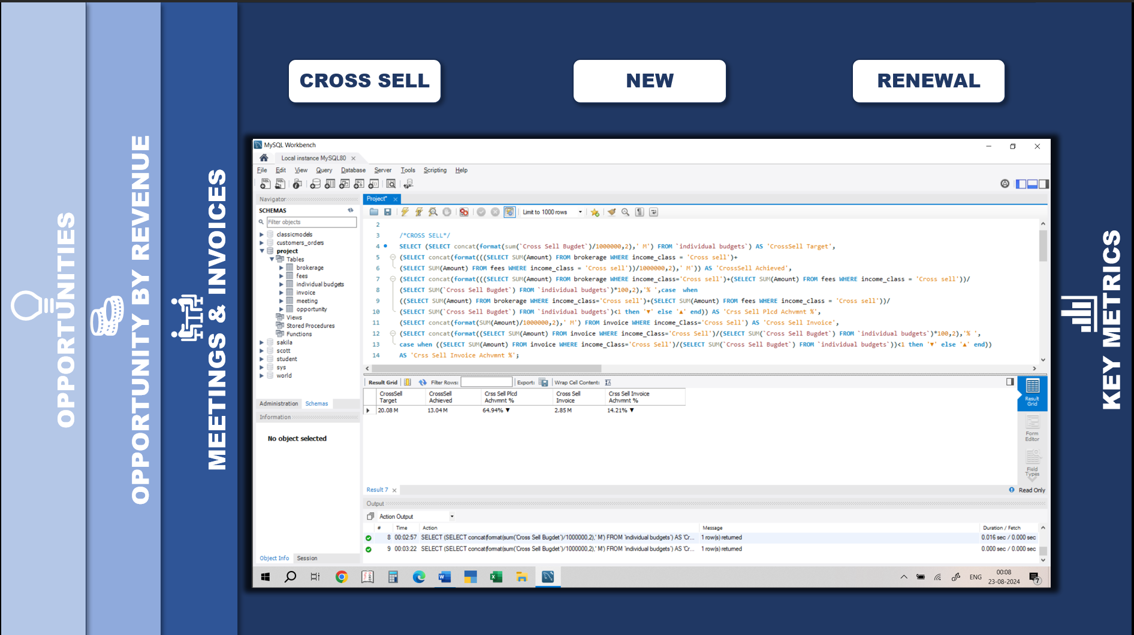
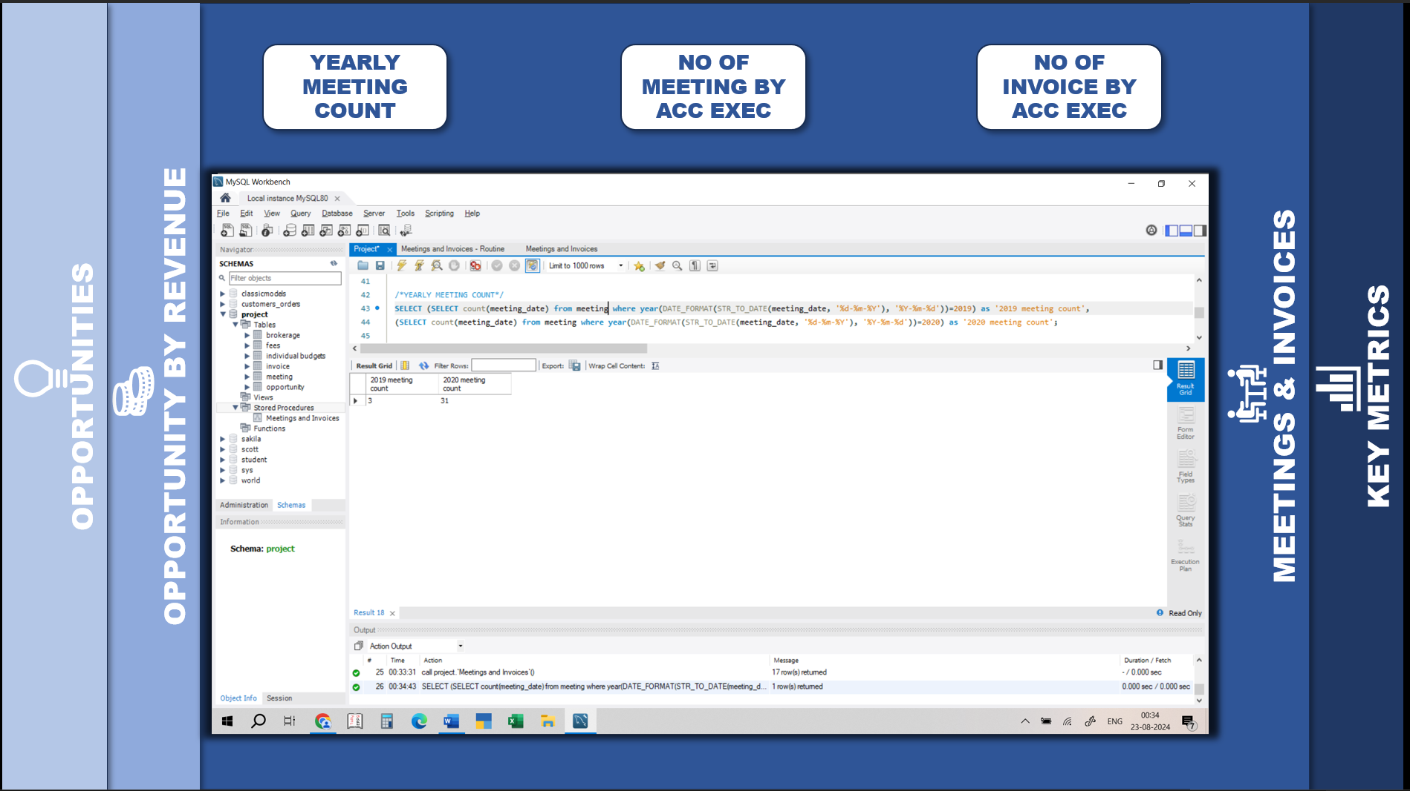
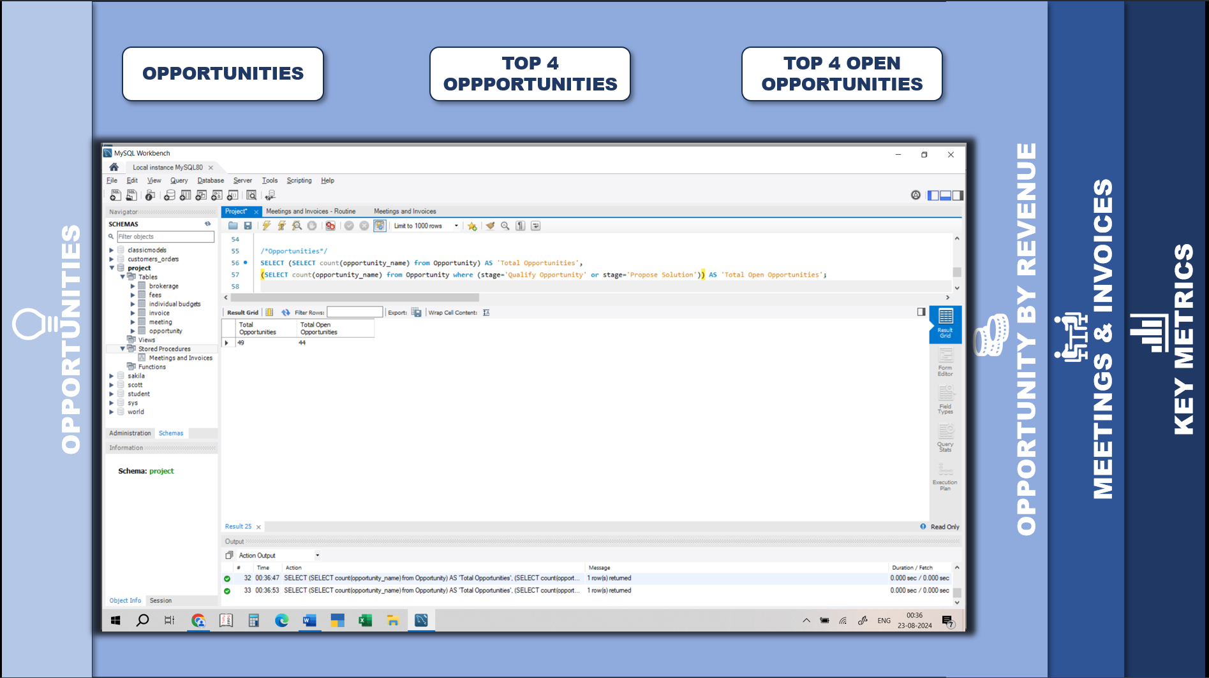
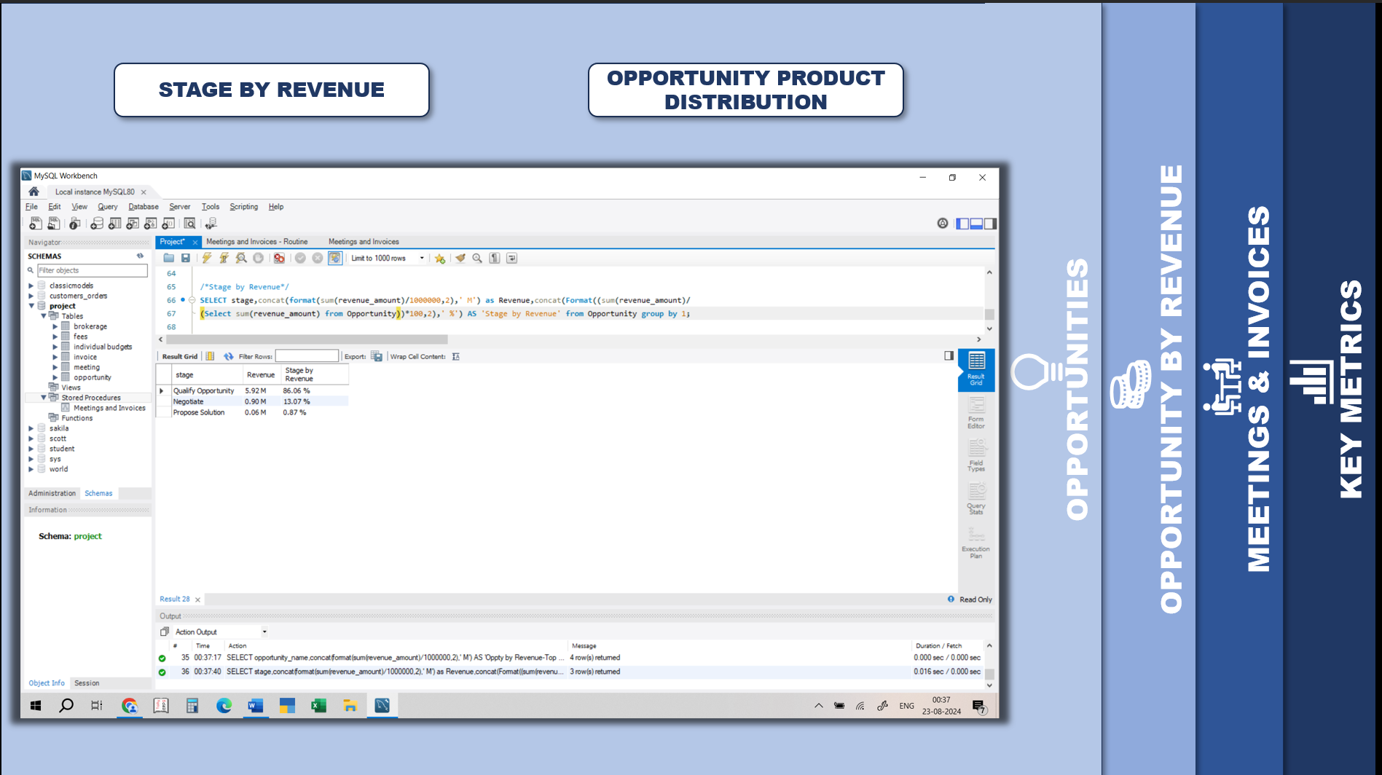
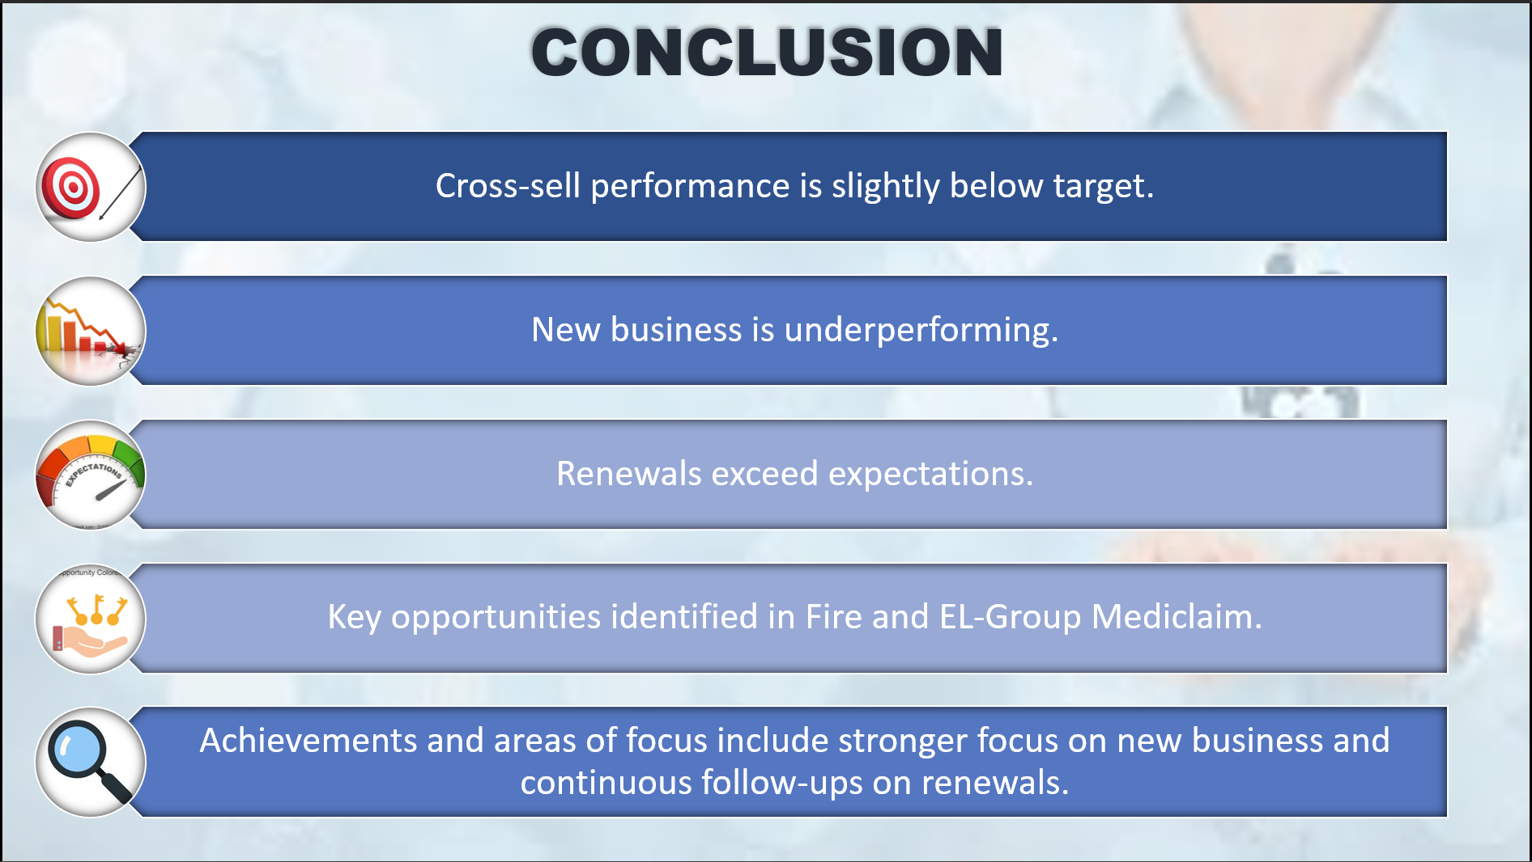

HOME

Slide 2



AHMEDABAD BRANCH INSURANCE REPORT
Nikita Yogesh Chavan
Sambathina Dhamanidhi
Shubham Laxman Chandere
Ajinkya Shivaji More
Siddhi Tembhurne
Pratikha Mohapatra
DATA ANALYTICS P – 590 Group - 2

Slide 3

OVERVIEW ON DATA, KEY METRICS & VISUALS
1
Dashboards from various tools presents the performance of the Ahmedabad branch, focusing on cross-sell, new and renewals Income
2
KPI’s were prepared from the below data available:
Brokerage: Brokerage received on account executive and income class wise.
Fees: Fees received on account executive and income class wise.
Individual Budgets: Targets were set for account executive on income class basis.
Invoice: Number of Invoices generated on account executive and income class wise.
Meeting: Number of meetings held and its details like attendance, date etc.
Opportunity: Opportunity details like Opportunity name,id, account exe, premium amount, revenue amount, stage, product group etc
Key Metrics:
Following visuals were provided in dashboard:
Yearly meeting count
No of meeting by account executives
No of invoices by account executives
No of opportunities and no of open opportunities
Opportunity by Revenue – Top 4
Stage by revenue
Opportunity product distribution
Open Opportunity – Top 4
3
PARTICULARS | CROSS SELL | NEW | RENEWAL
Target | 20.08M | 19.67M | 12.32M
Achieved | 13.04M | 3.53M | 18.51M
Invoice | 2.85M | 0.57M | 8.24M
Cross Sell Placed Achievement | 64.94%  | 17.95%  | 150.23% 
Cross Sell Invoice Achievement | 14.21%  | 2.90%  | 66.92% 
4

Slide 4

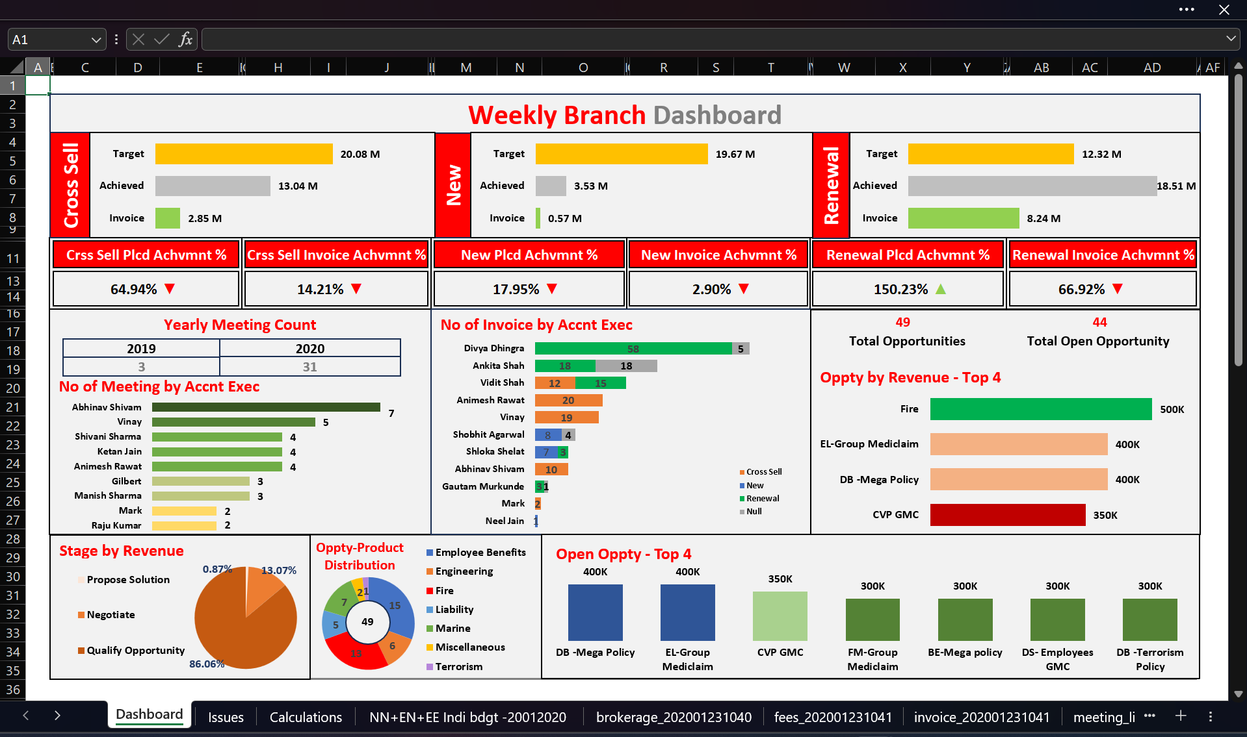

DASHBOARD PREPARED IN EXCEL

Slide 5

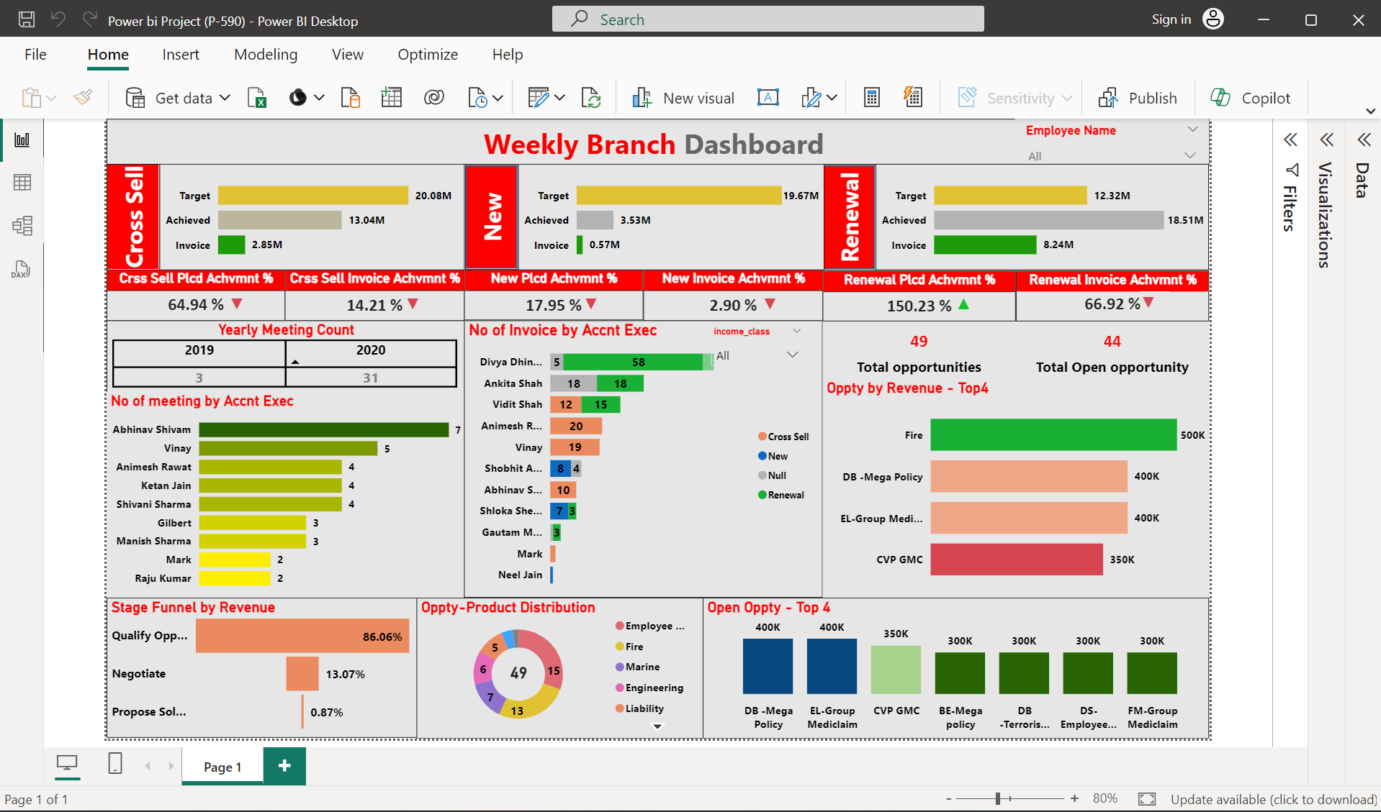
DASHBOARD PREPARED IN POWER BI

Slide 6

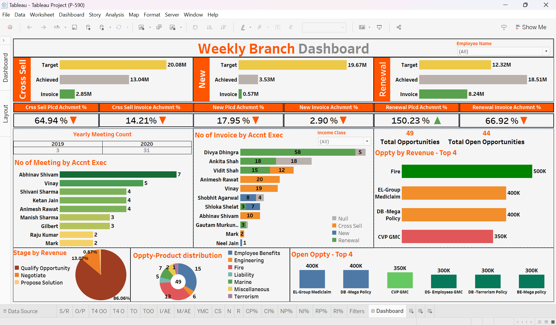
DASHBOARD PREPARED IN TABLEAU

Slide 7






OPPORTUNITIES
OPPORTUNITY BY REVENUE
MEETINGS & INVOICES
KEY METRICS
CODES IN MY SQL

Slide 8
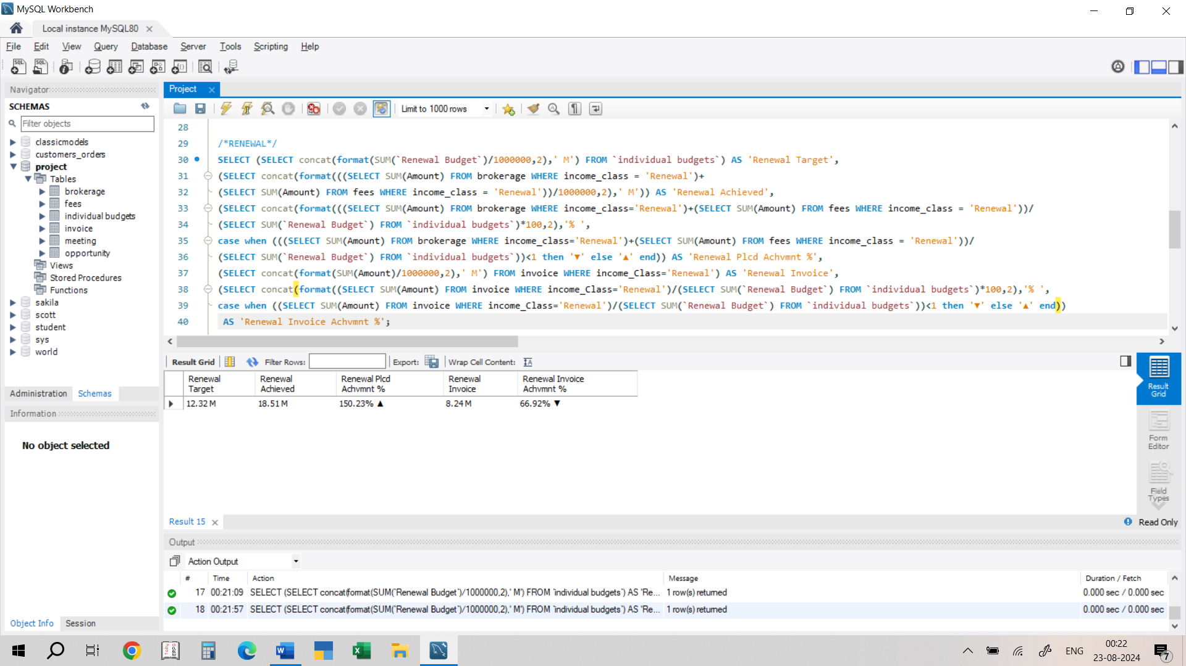

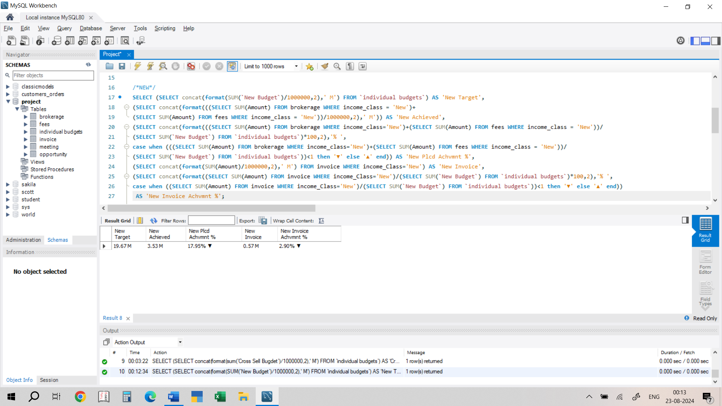
OPPORTUNITIES
OPPORTUNITY BY REVENUE
MEETINGS & INVOICES
KEY METRICS
CROSS SELL
NEW
RENEWAL
CODES IN MY SQL

Slide 9
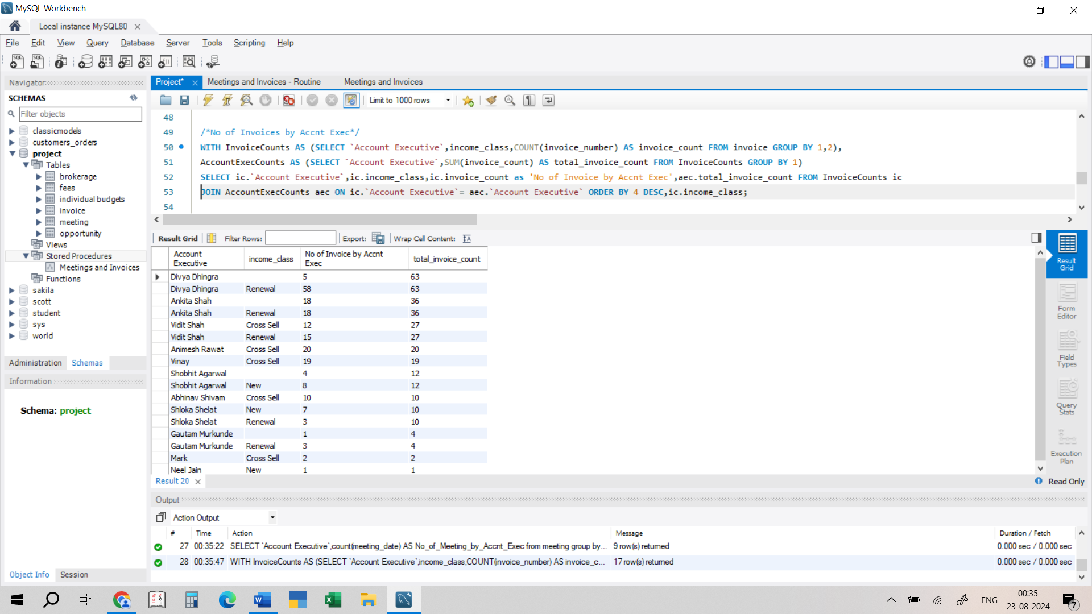
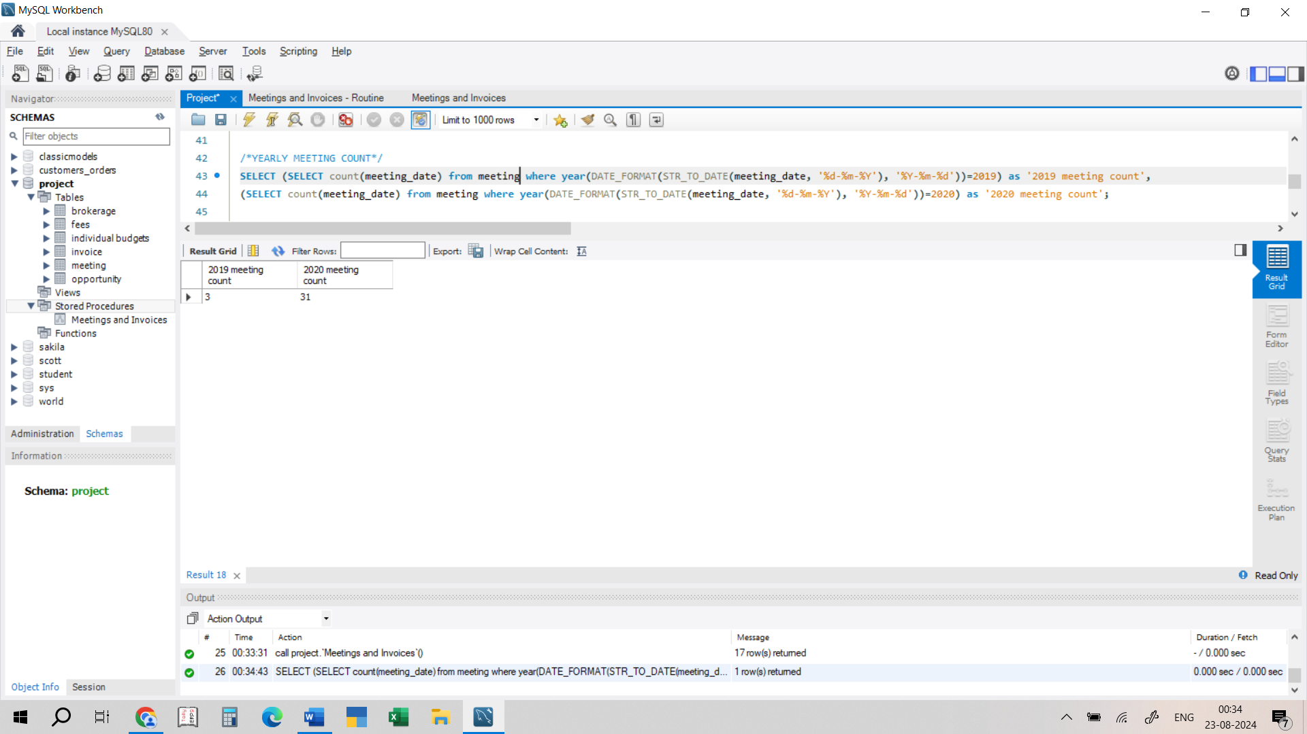
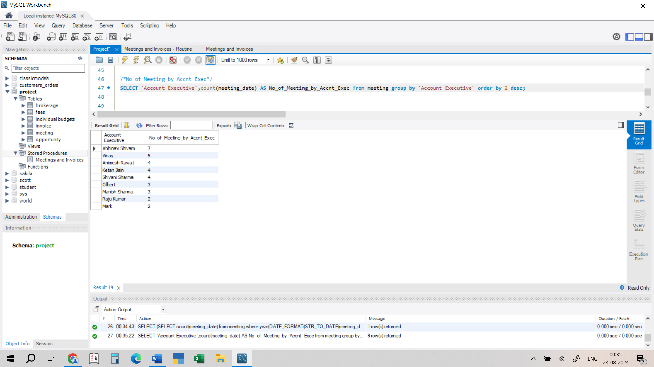
OPPORTUNITIES
OPPORTUNITY BY REVENUE
MEETINGS & INVOICES
KEY METRICS
YEARLY MEETING COUNT
NO OF MEETING BY ACC EXEC
NO OF INVOICE BY ACC EXEC
CODES IN MY SQL

Slide 10
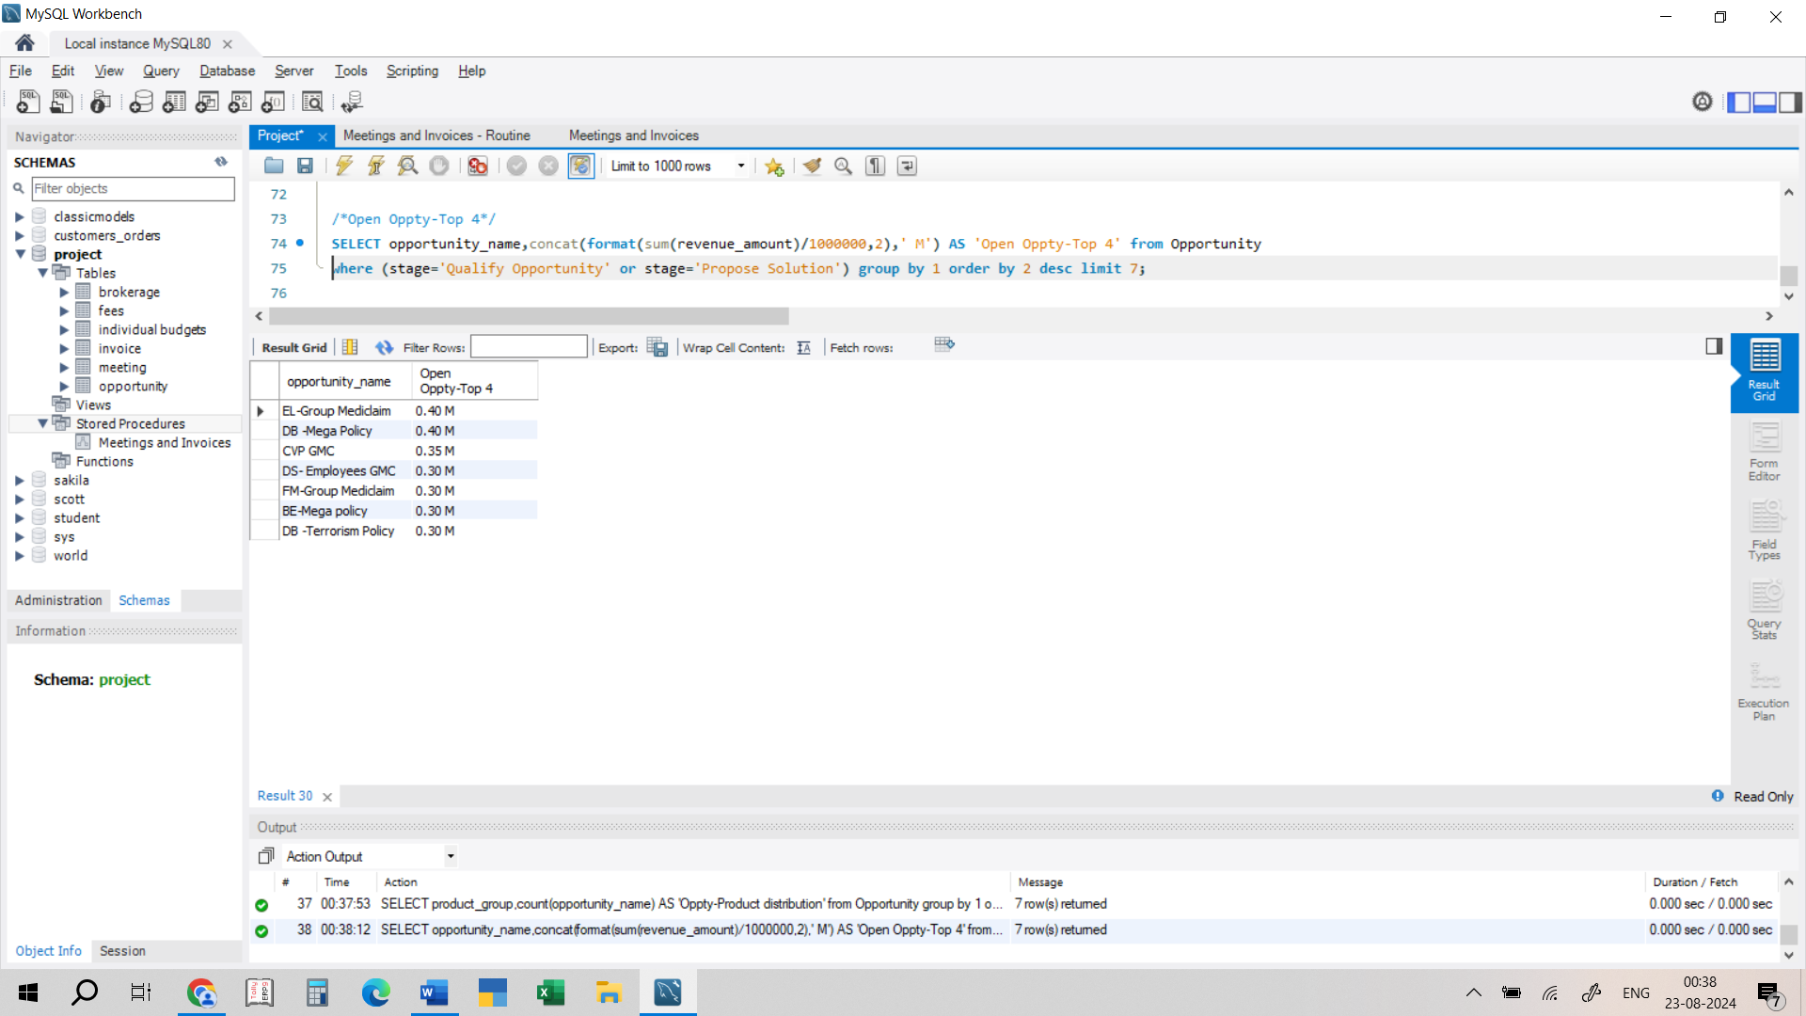
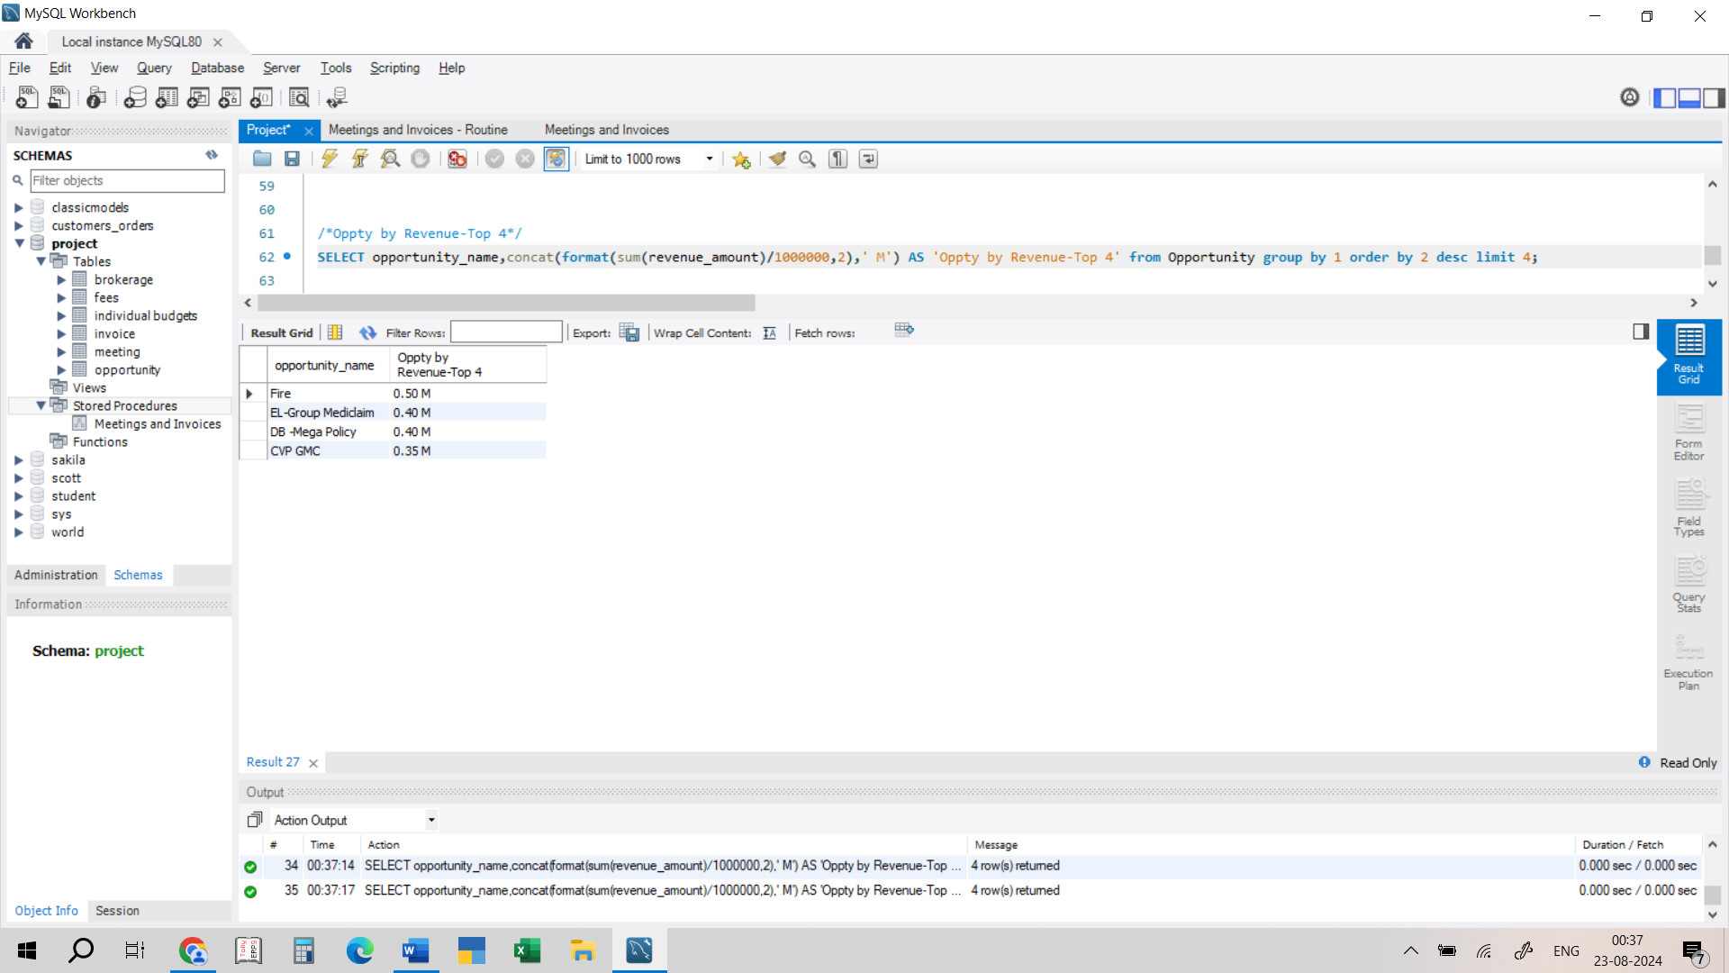
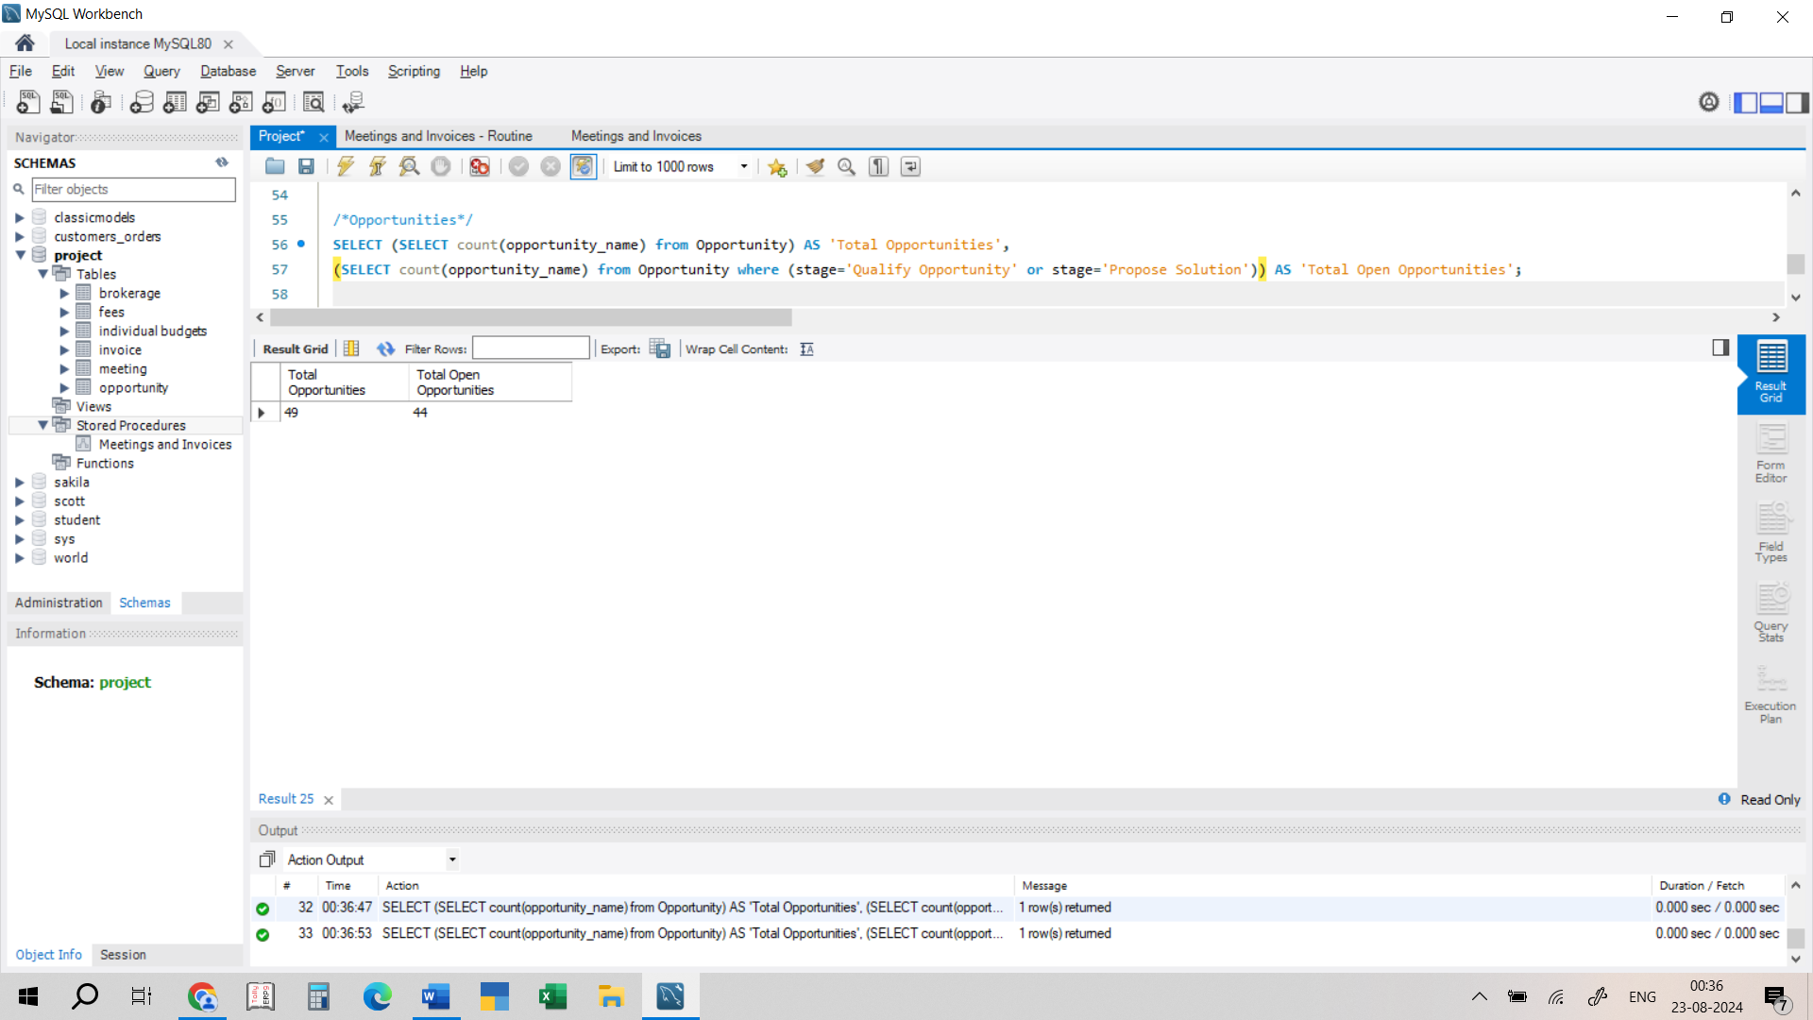
OPPORTUNITIES
OPPORTUNITY BY REVENUE
MEETINGS & INVOICES
KEY METRICS
OPPORTUNITIES
TOP 4 OPPPORTUNITIES
TOP 4 OPEN OPPORTUNITIES
CODES IN MY SQL

Slide 11
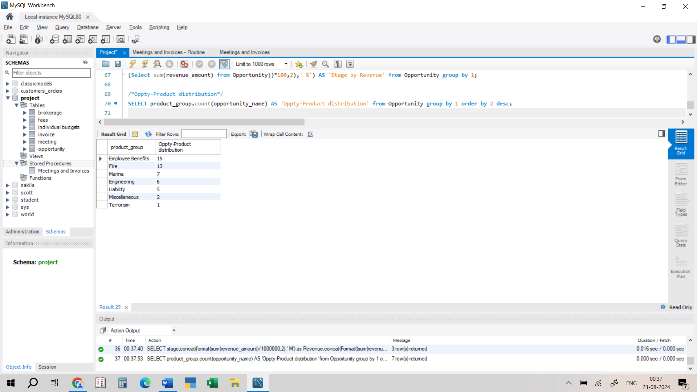
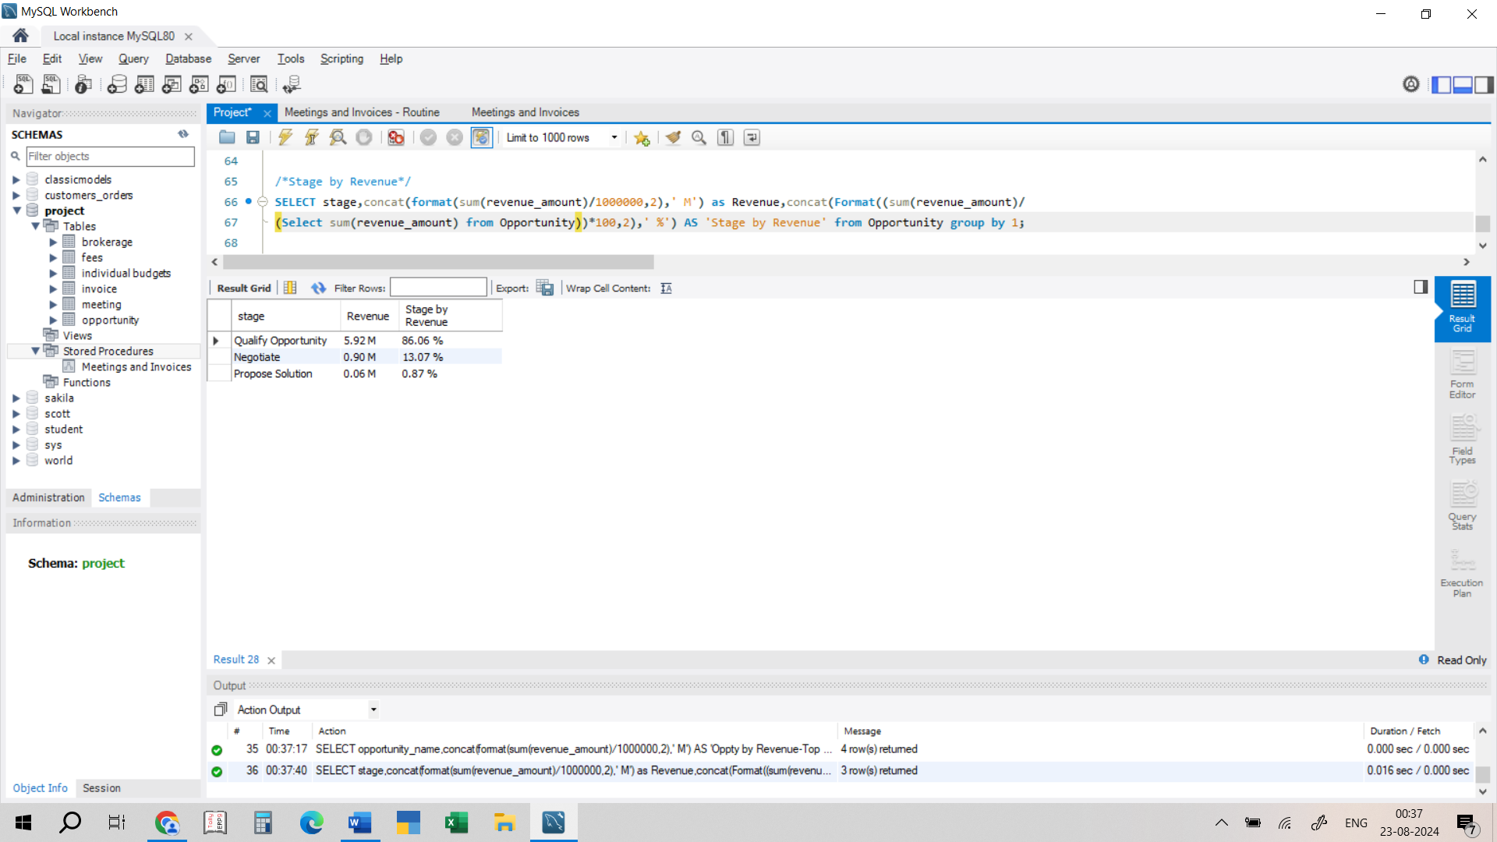
OPPORTUNITIES
OPPORTUNITY BY REVENUE
MEETINGS & INVOICES
KEY METRICS
STAGE BY REVENUE
OPPORTUNITY PRODUCT DISTRIBUTION
CODES IN MY SQL

Slide 12

CONCLUSION
Cross-sell performance is slightly below target.
New business is underperforming.
Renewals exceed expectations.
Key opportunities identified in Fire and EL-Group Mediclaim.
Achievements and areas of focus include stronger focus on new business and continuous follow-ups on renewals.

Slide 13


